Slide 1
PowerCo Case Study
Churn Prediction Analysis

Slide 2
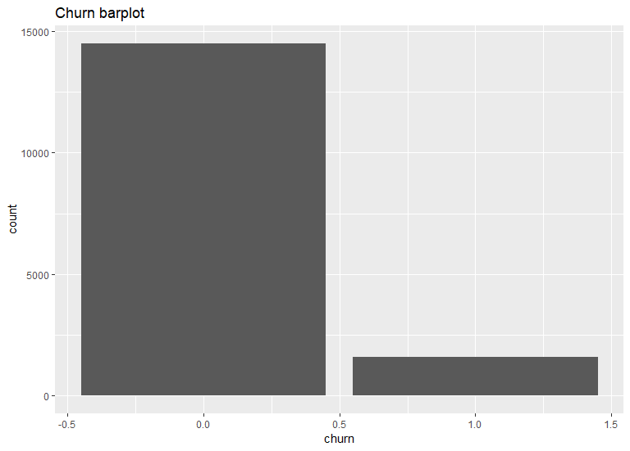
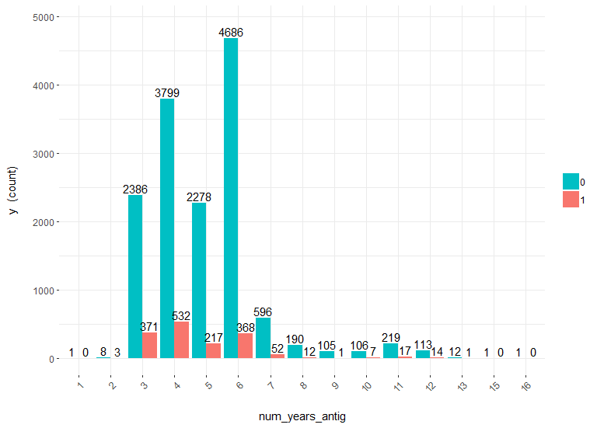

Explorative Data Analysis
Customer Fidelization

Slide 3
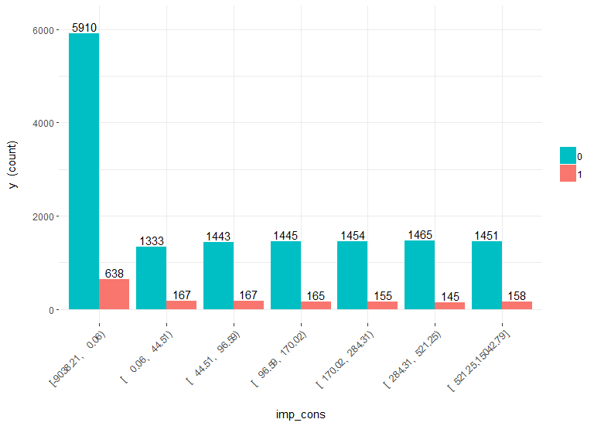
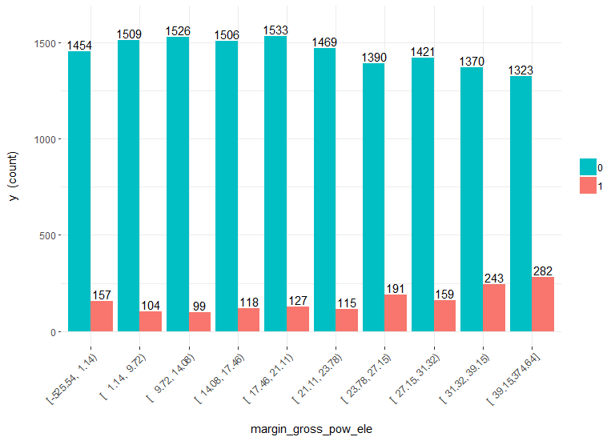
Churn compared with current paid consumption
Churn compared with gross margin on power subscription

Slide 4
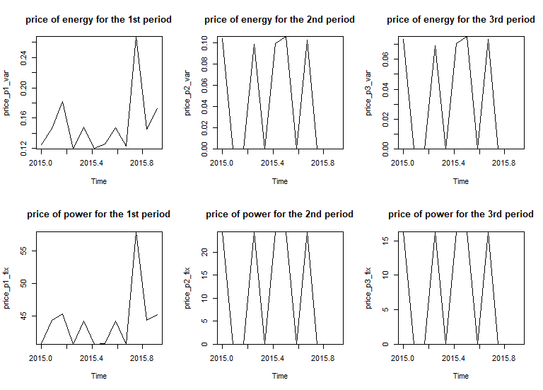
Prices Analysis

Slide 5
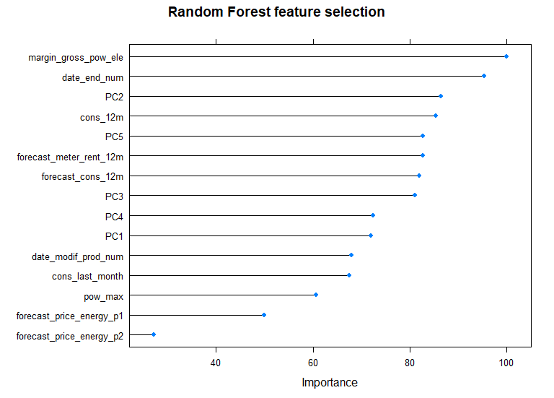
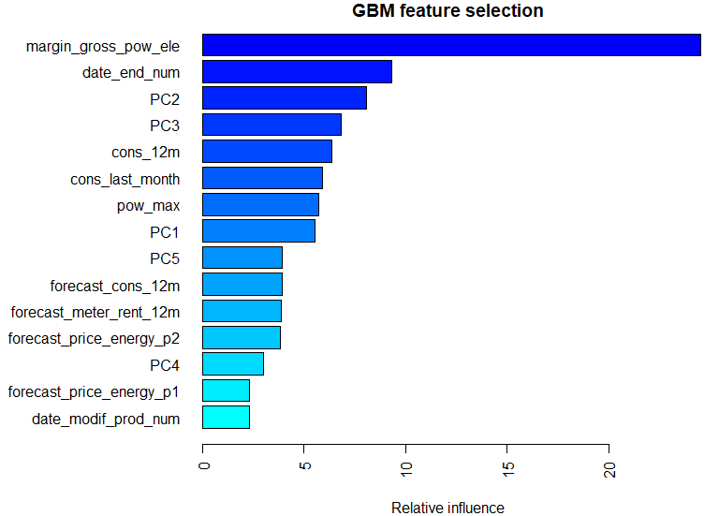
Driver Features

Slide 6
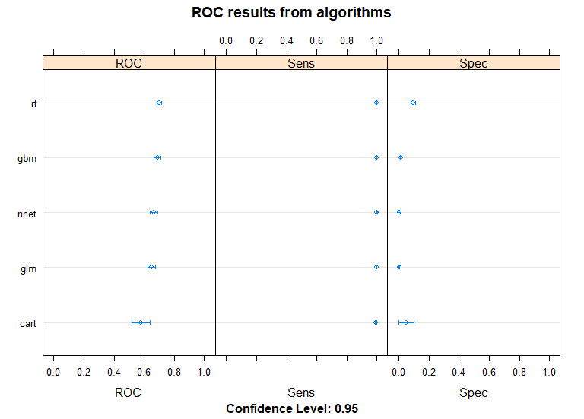
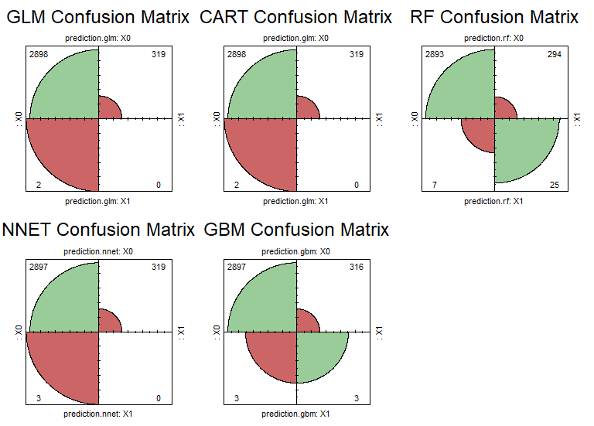
Algorithms Analysis

Slide 7
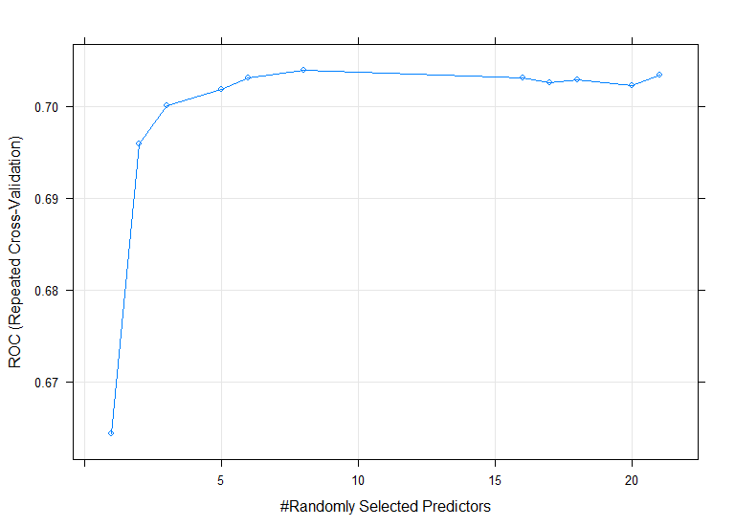
ROC Curve from Random Forest Tuning

Slide 8
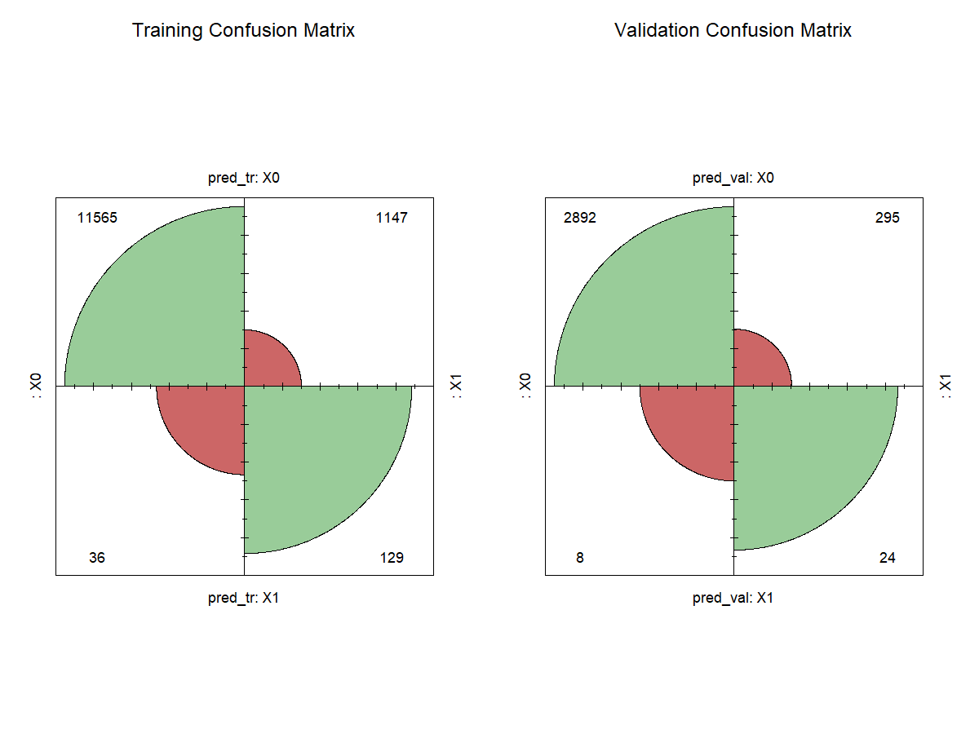
Confusion Matrix from Random Forest Model

Slide 9
Conclusion
Yes at 20% discount but then what will happen? Maybe will be need a new increase of prices to recover the margin
Suggested actions:
Maybe is better to improve services offered
Try to retain customers with fidelization actions
Clustering customers for better commercial actions

